Slide 1
Programming The Virtual World
Just Processing
Essential Methods in Processing
The Structure of a Processing program
Methods and Structure
The Sequencing Control Structure
Global and Local Variables
Variables, Types and Values
Ken Brownsey
The Selection Control Structure
The Repetition Control Structure
Repetition within Repetition
Arrays, Indices and Values
Don’t Fall Off!

Slide 2
int W = 400,
H = W;
color Red = color(255, 0, 0),
Green = color(0, 255, 0),
Blue = color(0, 0, 255),
Yellow = color(255, 255, 0),
Orange = color(255, 127, 0);
color BG_C = Yellow;
void setup() {
size(W, H);
}
void draw() {
}
void mousePressed() {
}
void keyPressed() {
}
Outline.pde
These are special methods in Processing
setup() is called when the program starts running.
Once setup() has completed draw() is called 60 times every second. This rate can be adjusted but it can’t make your computer any faster than it can do!
Each time draw() completes the system looks to see if any events such as mousePressed() or keyPressed() have occurred. If so then the relevant code is run.

Slide 3

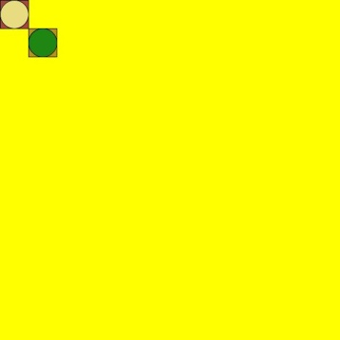
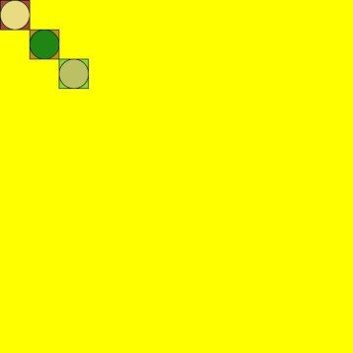
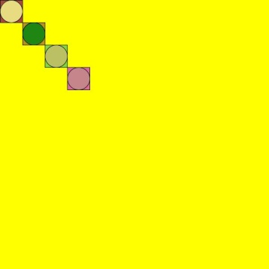
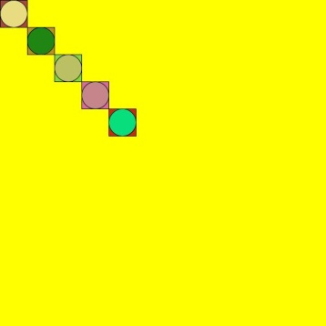
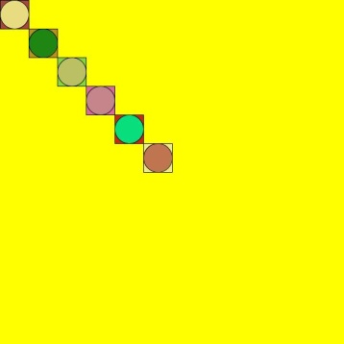
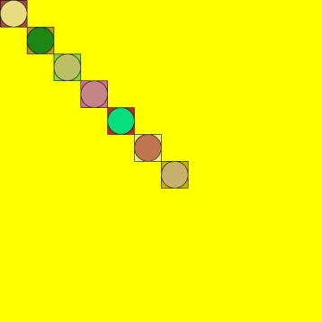
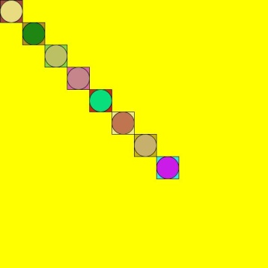
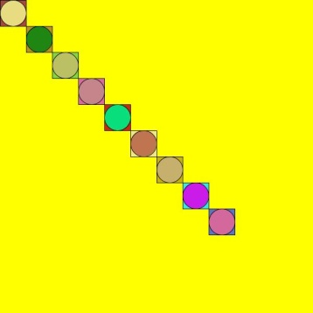
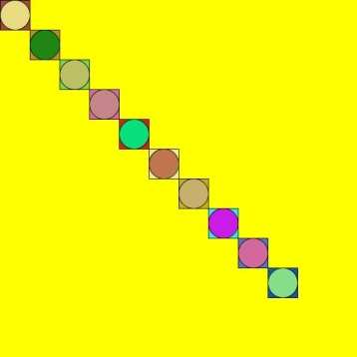
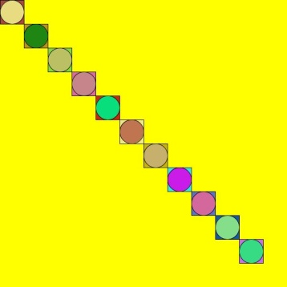
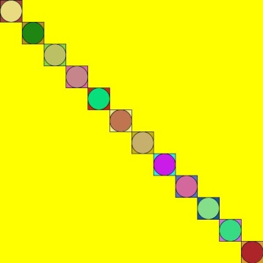
color Yellow = color(255, 255, 0),
Green = color(0, 255, 0),
Orange = color(255, 127, 0),
Blue = color(0, 0, 255),
Red = color(255, 0, 0);
color White = color(255, 255, 255),
Black = color(0, 0, 0);
int W = 600,
H = W;
int R = 25;
int i = R;
color RandCol() {
color Col;
float R = random(256),
G = random(256),
B = random(256);
Col = color(R, G, B);
return(Col);
}
SimpleProcProg1.pde

Slide 4
void setup() {
size(W, H);
background(Yellow);
smooth();
rectMode(CENTER);
}
void draw() {
}
int P = 0;
void mousePressed() {
if (i < W) {
fill(RandCol());
rect(i, i, 2 * R, 2 * R);
fill(RandCol());
ellipse(i, i, 2 * R, 2 * R);
i = i + 2 * R;
save("SPP1_" + P + ".jpg");
P++;
}
}
SimpleProcProg1.pde

Slide 5
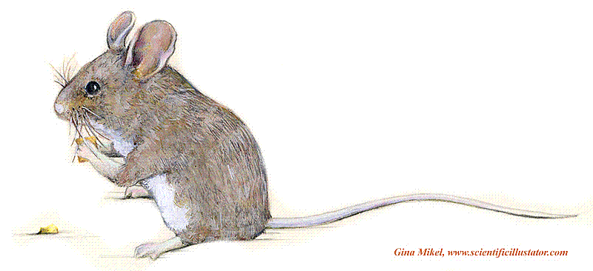
The Sequencing Control – One Thing After Another!
Do this
1
void setup() {
size(W, H);
background(Yellow);
smooth();
rectMode(CENTER);
}
Then do this
2
Then do this
void mousePressed() {
if (i < W) {
fill(RandCol());
rect(i, i, 2 * R, 2 * R);
fill(RandCol());
ellipse(i, i, 2 * R, 2 * R);
i = i + 2 * R;
save("SPP1_" + P + ".jpg");
P++;
}
}
3
Then do this
4
Then do this
5

Slide 6
Method Structure
SimpleProcProg1.pde
setup()
draw()
mousePressed()
fill()
ellipse()
rect()
save()
color()
size()
smooth()
‘Backbone’ Method
background()
rectMode()
RandCol()
Other Processing Method
random()
SimpleProcProg1.pde
User Defined Method

Slide 7
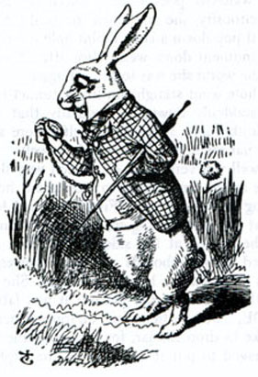
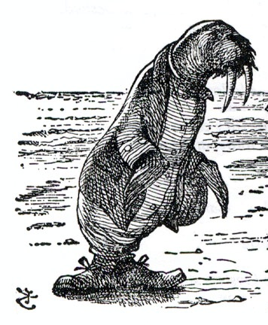

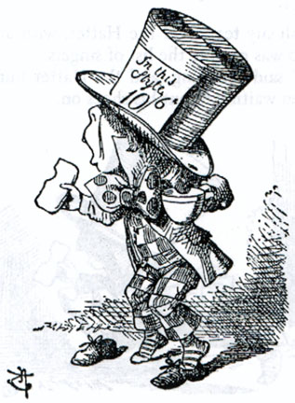
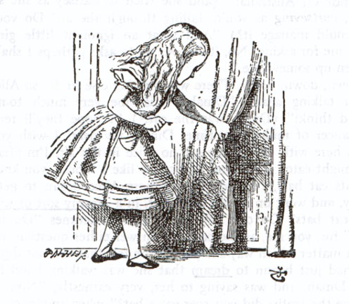
Builders and Others
….and I employ
Ms. Alice, the electrician,
Mr. Walrus, the plumber,
Mr. Carpenter, the ..urmm.. Carpenter,
and young Hatter the bricklayer.
I am Mr. Rabbit the builder….
Naturally my essential organising role….
So who’s building this bloomin’ house!!!!

Slide 8
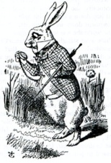



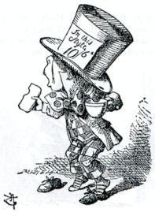
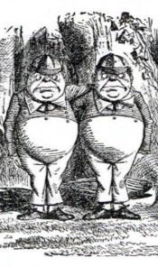
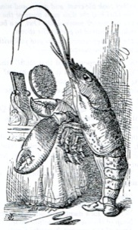
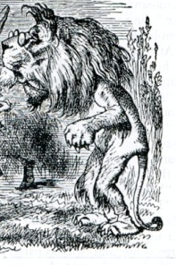
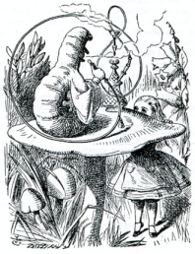
Structure in Business
Using subroutines is like delegation. The rabbit has a point. Someone has to know who to call in and when. In fact they might call in others!

Slide 9
Variables (1)
color Yellow = color(255, 255, 0);
int W = 600,
H = W;
int R = 25;
int i = R;
color RandCol() {
color Col;
float R = random(256),
G = random(256),
B = random(256);
Col = color(R, G, B);
return(Col);
}
void setup() {
size(W, H);
background(Yellow);
smooth();
rectMode(CENTER);
}
void draw() {
}
Variables are entities that can vary in value but do not have to.
CENTER is a ‘built in constant’ not a variable.
SimpleProcProg1.pde

Slide 10
Variables (2)
int P = 0;
void mousePressed() {
if (i < W) {
fill(RandCol());
rect(i, i, 2 * R, 2 * R);
fill(RandCol());
ellipse(i, i, 2 * R, 2 * R);
i = i + 2 * R;
save("SPP1_" + P + ".jpg");
P++;
}
}
SimpleProcProg1.pde

Slide 11
color Yellow = color(255, 255, 0);
int W = 600,
H = W;
int R = 25;
int i = R;
color RandCol() {
color Col;
float R = random(256),
G = random(256),
B = random(256);
Col = color(R, G, B);
return(Col);
}
……………………………………….
int P = 0;
void mousePressed() {
if (i < W) {
fill(RandCol());
rect(i, i, 2 * R, 2 * R);
fill(RandCol());
ellipse(i, i, 2 * R, 2 * R);
i = i + 2 * R;
save("SPP1_" + P + ".jpg");
P++;
}
}
color Yellow = color(255, 255, 0);
int W = 600,
H = W;
int R = 25;
int i = R;
color RandCol() {
color Col;
float R = random(256),
G = random(256),
B = random(256);
Col = color(R, G, B);
return(Col);
}
……………………………………….
int P = 0;
void mousePressed() {
if (i < W) {
fill(RandCol());
rect(i, i, 2 * R, 2 * R);
fill(RandCol());
ellipse(i, i, 2 * R, 2 * R);
i = i + 2 * R;
save("SPP1_" + P + ".jpg");
P++;
}
}
Global Variables
Local Variables
Variables (3)

Slide 12
color Yellow = color(255, 255, 0);
int W = 600,
H = W;
int R = 25;
int i = R;
color RandCol() {
color Col;
float R = random(256),
G = random(256),
B = random(256);
Col = color(R, G, B);
return(Col);
}
void setup() {
}
void draw() {
}
int P = 0;
void mousePressed() {
if (i < W) {
……………………….
P++;
}
}
A method definition can access any of the variables declared globally…
...except if there is a local variable of the same name….
...then the global variable’s scope ‘cannot see inside’ the definition of the method.
color RandCol() {
color Col;
float R = random(256),
G = random(256),
B = random(256);
Col = color(R, G, B);
return(Col);
}
void setup() {
}
void draw() {
}
R
Variables (4)
color RandCol() {
color Col;
float R = random(256),
G = random(256),
B = random(256);
Col = color(R, G, B);
return(Col);
}
void mousePressed() {
if (i < W) {
……………………….
P++;
}
}
Cannot ‘see’

Slide 13
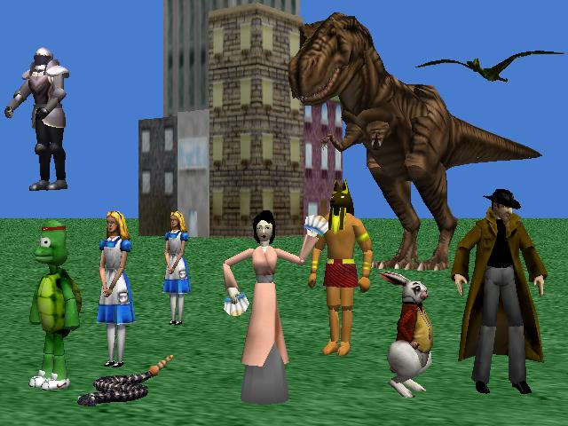
In Alice all the objects you used had a set of variables defining their values such as size, position, orientation and so on. An object is a complex variable.
Variables (5)
Some Complex Variables

Slide 14
Variables have a
Name
Type
Value
color Yellow = color(255, 255, 0);
int W = 600,….
W is of type int, i.e. it can only assume integer values. It is assigned the value 600 initially.
Name
W
Type
int
Value
600
Yellow is of type color. There is also a method called color. This takes three int parameters, for the red, green and blue components respectively, and returns the color value created. Note that Yellow is the name we gave it. It seems sensible but as far as Processing is concerned we could have called it Homer or Red or xzt…
Name
Yellow
Type
color
Value
color(255, 255, 0)

Slide 15
Selection – Choosing one or other path!
void mousePressed() {
if (i < W) {
fill(RandCol());
rect(i, i, 2 * R, 2 * R);
fill(RandCol());
ellipse(i, i, 2 * R, 2 * R);
i = i + 2 * R;
save("SPP1_" + P + ".jpg");
P++;
}
}
?
Condition returns a boolean value – i.e. true or false
if reserved word
if (i < W) {
fill(RandCol());
rect(i, i, 2 * R, 2 * R);
fill(RandCol());
ellipse(i, i, 2 * R, 2 * R);
i = i + 2 * R;
save("SPP1_" + P + ".jpg");
P++;
}
Brackets to determine sequence of instructions to be executed if the condition is true. Not required if there is only one instruction but advisable even in that case!

Slide 16
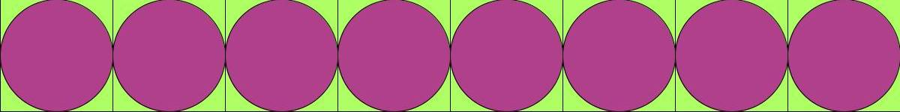
color Black = color(0, 0, 0);
int R = 75;
int N = 8;
int W = 2 * R * N,
H = 2 * R;
color C1 = RandCol(),
C2 = RandCol();
color RandCol() {
……………………..(As before)
}
void setup() {
size(W, H);
background(Black);
smooth();
rectMode(CENTER);
}
void draw() {
int i;
for(i = 0; i < N; i++) {
fill(C1);
rect((2 * i + 1) * R, R, 2 * R, 2 * R);
fill(C2);
ellipse((2 * i + 1) * R, R, 2 * R, 2 * R);
}
}
Repetition – Do a number of times (1)
SimpleProcProg2a.pde

Slide 17
Repetition – Do a number of times (2)
for(i = 0; i < 4; i++) {
……………
}
Do 1 followed by 2.
If we have been round 4 times then end the loop..
1
2
?
..otherwise go back

Slide 18
Repetition – Do a number of times (3)
Continuation condition returns true or false
for reserved word
Initial condition
Loop update
for(i = 0; i < N; i++) {
fill(C1);
rect((2 * i + 1) * R, R, 2 * R, 2 * R);
fill(C2);
ellipse((2 * i + 1) * R, R, 2 * R, 2 * R);
}
1
2
Brackets to determine sequence of instructions to be executed if the continuation condition is true. Not required if there is only one instruction but advisable even in that case!
?

Slide 19
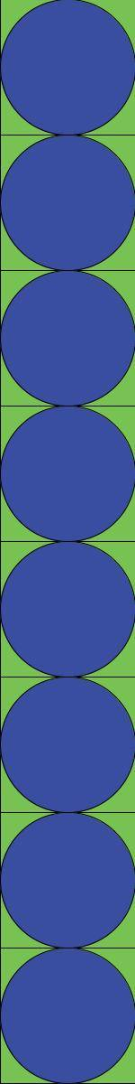
color Black = color(0, 0, 0);
int R = 75;
int N = 8;
int H = 2 * R * N,
W = 2 * R;
color C1 = RandCol(),
C2 = RandCol();
color RandCol() {
……………………..(As before)
}
void setup() {
size(W, H);
background(Black);
smooth();
rectMode(CENTER);
}
void draw() {
int i;
for(i = 0; i < N; i++) {
fill(C1);
rect(R, (2 * i + 1) * R, 2 * R, 2 * R);
fill(C2);
ellipse(R, (2 * i + 1) * R, 2 * R, 2 * R);
}
}
SimpleProcProg2b

Slide 20
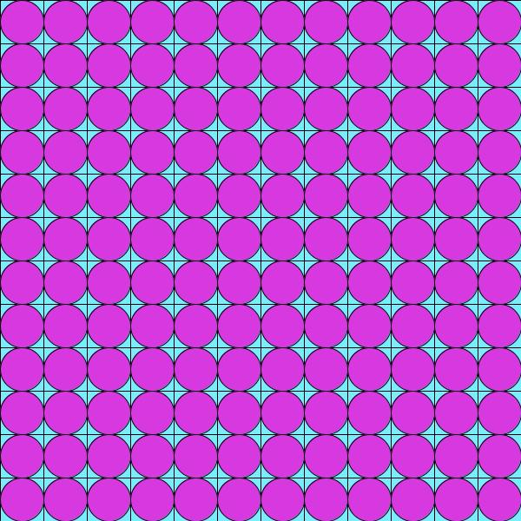
int R = 25;
int N = 12;
int W = 2 * R * N,
H = W;
color C1,
C2;
color RandCol() {
……………………..(As before)
}
void setup() {
size(W, H);
smooth();
rectMode(CENTER);
C1 = RandCol();
C2 = RandCol();
}
void draw() {
int i, j;
for(i = 0; i < N; i++) {
for(j = 0; j < N; j++) {
fill(C1);
rect((2 * i + 1) * R, (2 * j + 1) * R, 2 * R, 2 * R);
fill(C2);
ellipse((2 * i + 1) * R, (2 * j + 1) * R, 2 * R, 2 * R);
}
}
}
SimpleProcProg3.pde

Slide 21
Repetition within Repetition
for(i = 0; i < N; i++) {
for(j = 0; j < N; j++) {
…………………
}
}
1
?
2
?

Slide 22
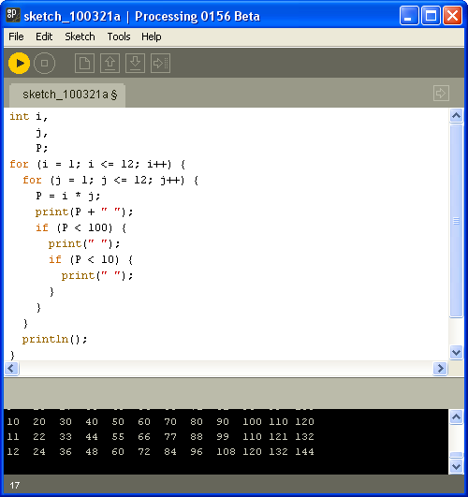
1 2 3 4 5 6 7 8 9 10 11 12
2 4 6 8 10 12 14 16 18 20 22 24
3 6 9 12 15 18 21 24 27 30 33 36
4 8 12 16 20 24 28 32 36 40 44 48
5 10 15 20 25 30 35 40 45 50 55 60
6 12 18 24 30 36 42 48 54 60 66 72
7 14 21 28 35 42 49 56 63 70 77 84
8 16 24 32 40 48 56 64 72 80 88 96
9 18 27 36 45 54 63 72 81 90 99 108
10 20 30 40 50 60 70 80 90 100 110 120
11 22 33 44 55 66 77 88 99 110 121 132
12 24 36 48 60 72 84 96 108 120 132 144
int i,
j,
P;
for (i = 1; i <= 12; i++) {
for (j = 1; j <= 12; j++) {
P = i * j;
print(P + " ");
if (P < 100) {
print(" ");
if (P < 10) {
print(" ");
}
}
}
println();
}

Slide 23
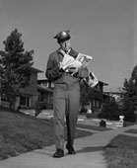
Acacia Avenue
1
2
3
4
5
6
A street is an array of houses
Number 3
Acacia Avenue
If we know the street name and the house number then we can call there.
So if we want to know who lives at 3 Acacia Avenue we can call there.

Slide 24
An Array is a Data Structure
int i;
int[] Nums = new int[6];
for (i = 0; i < 6; i++) {
Nums[i] = i * i;
}
for (i = 0; i < 6; i++) {
print(Nums[i] + " ! ");
}
Array indices
Why is an array of numbers like a street of houses?
0
1
2
3
4
5
Before for..
0
33
71
0
97
-8
i value
0
0
33
71
0
97
-8
Cell number 2 contains the value 4
1
0
1
71
0
97
-8
2
0
1
4
0
97
-8
In C/Java languages arrays always index from 0 not 1.
3
0
1
4
9
97
-8
4
0
1
4
9
16
-8
5
0
1
4
9
16
25

Slide 25
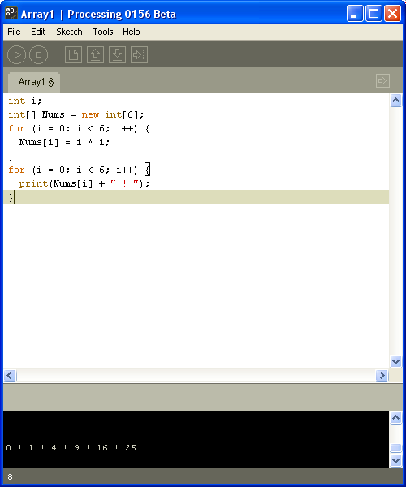
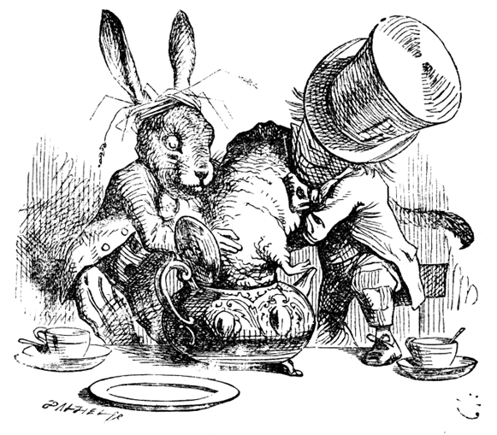
Array1.pde
You put them in..
0 ! 1 ! 4 ! 9 ! 16 ! 25 !
..and you take them out.

Slide 26
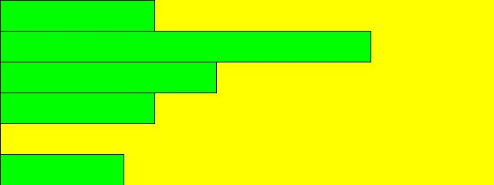
int Step = 40;
int W = Step * 16,
H = 6 * Step;
int[] Nums = new int[6];
color Yellow = color(255, 255, 0),
Green = color(0, 255, 0);
void setup() {
int i;
size(W, H);
Nums[0] = 5;
Nums[1] = 12;
Nums[2] = 7;
Nums[3] = 5;
Nums[4] = 0;
Nums[5] = 4;
}
void draw() {
}
Array2.pde
int P = 0;
void mousePressed() {
int i;
background(Yellow);
fill(Green);
for(i = 0; i < 6; i++) {
rect(0, Step * i, Step * Nums[i], Step);
}
}
Not in output

Slide 27
int Step = 40;
int W = Step * 16,
H = 6 * Step;
int[] Nums = new int[6];
color Yellow = color(255, 255, 0),
Green = color(0, 255, 0);
void setup() {
int i;
size(W, H);
Nums[0] = 5;
Nums[1] = 12;
Nums[2] = 7;
Nums[3] = 5;
Nums[4] = 0;
Nums[5] = 4;
background(Yellow);
}
void draw() {
}
Array3.pde
int i = 0;
void mousePressed() {
fill(Green);
rect(0, Step * i, Step * Nums[i], Step);
i++;
}

Slide 28

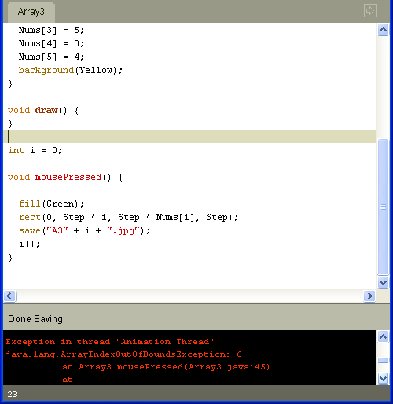
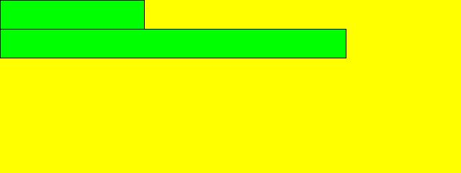
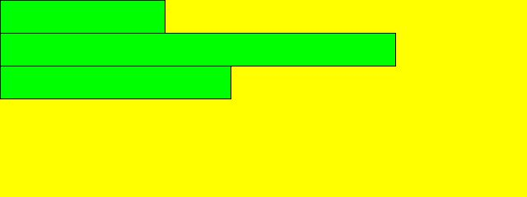
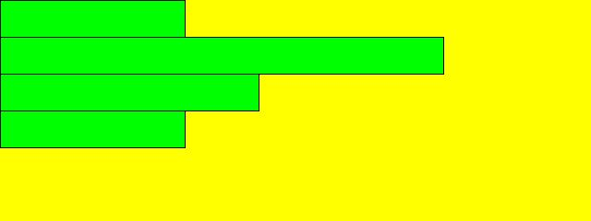
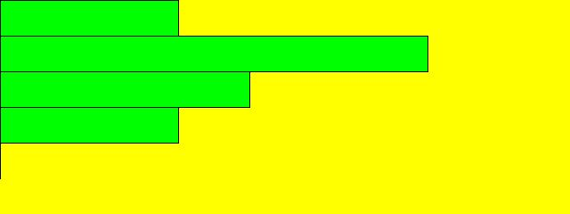
In C/Java languages arrays always index from 0 not 1.
i == 6
Oops!
Array3.pde
0
1
2
3
4
5

Slide 29
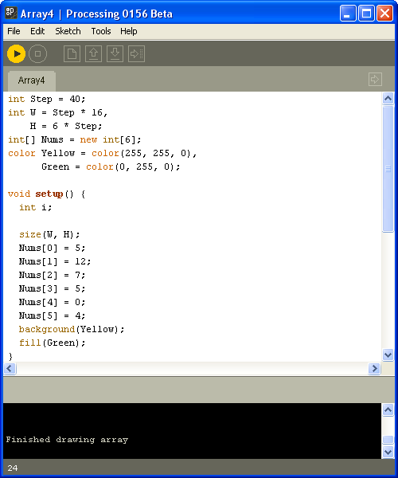

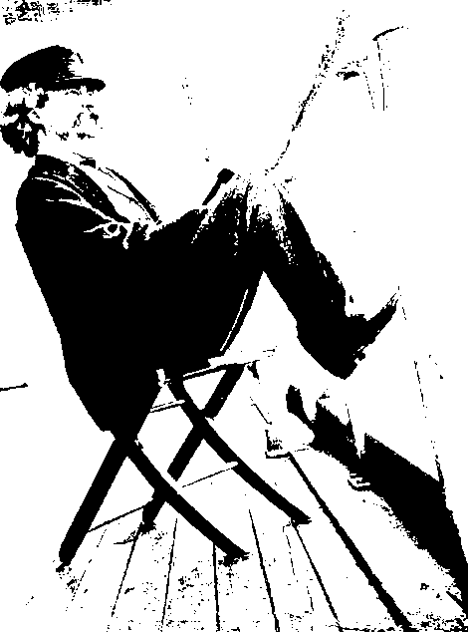





Array4.pde
= - mousePressed +
Array3.pde
int i = 0;
void mousePressed() {
if (i < 6) {
rect(0, Step * i, Step * Nums[i], Step);
i++;
}
else {
println("Finished drawing array");
}
}
Falling off the end of your array is much worse than falling off your chair!
Finished drawing array

Slide 30
int R = 3,
C = 5;
int[][] TDA = new int[R][C];
int i,
j;
for(i = 0; i < R; i++) {
for(j = 0; j < C; j++) {
print(TDA[i][j]);
}
println();
}
for(i = 0; i < R; i++) {
for(j = 0; j < C; j++) {
TDA[i][j] = i * j;
}
}
println("********************");
for(i = 0; i < R; i++) {
for(j = 0; j < C; j++) {
print(TDA[i][j]);
}
println();
}
A 2-Dimensional Array
00000
00000
00000
********************
00000
01234
02468

